Slide 1
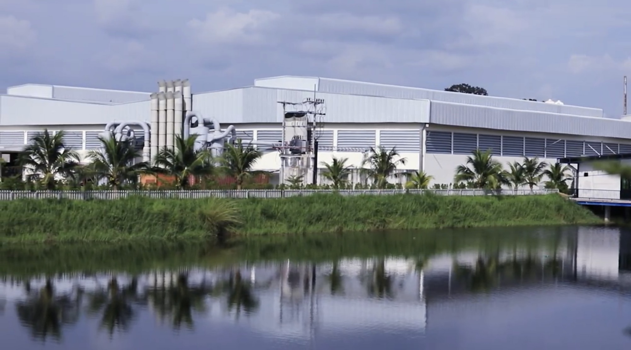
THAI - KIN
CSR REPORT
2 0 1 7
www.thai-kin.com

Slide 2
THAI - KIN
CSR Report 2017
Index
About CSR Reporting ................................................... 2
Management Message ……………………………………………. 3
CSR at Thai – Kin ……………………………………………………… 4
Corporate Governance ……………………………………………. 8
Corporate Strategy, Business Philosophy and Other Policies ... 8
Become a trusted strategic partner ………………………………….. 9
The Audit Committee ……………………………………………………... 10
The remuneration Committee ……………………………………...… 11
Internal Audit ………………………………………………………………... 12
Ethics and Compliance …………………………………………… 13
Corporate Integrity Management ………………………………….. 13
Human resources ………………………………………………….. 18
Employee Data .……………………………………………………………. 18
Diversity .………………………………………………………………………. 18
Recruitment ……………..………………………………………………….. 19
Employment contracts ……………………………………………..…. 19
Training and Talent Development ………………………………… 20
Communication …………………………………………………………… 22
Occupational Health and Safety ………………………………….. 24
Environment ..……………………………………………………… 27
Community Engagement ………………………………………. 29

Slide 3
About CSR Reporting
THAI - KIN
CSR Report 2017
Thai-Kin is very aware of the impact of our business on the rest of the society, including our stakeholders and the environment. Our corporate social responsibility (CSR) specific plan is a very broad concept that addresses many various topics such as human rights, corporate governance, health and safety, environment effect, working condition and contribution to economic development. Moreover, we have a desire to drive change towards sustainability.
Thai-Kin issued Annual reports including its Annual meeting of AGM and CSR information.
In order to update disclosure information accompanying changes in Thai – Kin’s scope of business and circumstance, Thai – Kin has been disclosing and summarized its Corporate Social Responsibility (CSR) activities of Thai – Kin during fiscal 2017 on this report.

Slide 4
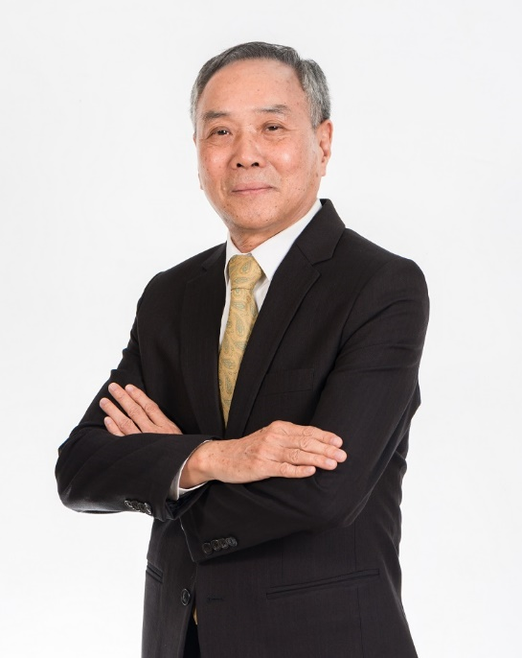
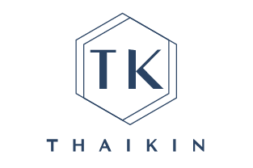
THAI - KIN
CSR Report 2017
Message from Management
MR. HSU TA CHIN
CHAIRMAN
THAI-KIN CO.,LTD.

Slide 5
CSR at THAI - KIN
THAI - KIN
CSR Report 2017
Corporate Governance
Ethics & Resources
Humane resources
Environment
Community Engagement
CSR key
Area of Focus
Company today are expected to engage in responsible business conduct. Thai – Kin’s corporate social responsibility (CSR) activities reflect its philosophy of implementing metal casting business practices, and product design and development, services and content that ultimate design and high quality.
In order to help build a more sustainable world, Thai – Kin employs its CSR initiatives as a measure of the social impact of its business operations. At the same time, Thai – Kin is engaged in ongoing efforts to contribute to society while enhancing corporate value.

Slide 6
THAI - KIN
CSR Report 2017
CSR key Area of Focus
Thai – Kin presently promotes CSR initiatives as reported by its CSR agenda, which focus on five set of key areas – ethic and compliance, corporate governance, human resources, community engagement, environment and with the goal of concentrating its operating foundation and continuously raising its corporate value. Stakeholder input on CSR – related department (e.g. compliance, environment, product quality, and human resources), to be incorporated into key actions, including the formulation of Thai – Kin policies. Thai – Kin’s CSR section is designate with monitoring to progress of initiatives and disclosing information about Thai – kin’s effort by preparing CSR reports and promoting dialogue with stakeholder.

Slide 7
THAI - KIN
CSR Report 2017
Relationship between Thai – Kin business activities and Sustainable Development Goals
SDGs’ that Thai – Kin’s business activities can help to achieve
Opportunity
Risk
THAI – KIN
From concept to store shelves
SDG’s that Thai – Kin can help to achieve in coordinate with its business

Slide 8
THAI - KIN
CSR Report 2017
Sustainable Development Goals (SDGs) are a collection of 17 global goals set by the United Nations. The broad goals are interrelated though each has its own targets to achieve.

Slide 9
THAI - KIN
CSR Report 2017
Corporate
Governance
Corporate Strategy, Business Philosophy and Other Policies
Persist in product quality
THAI KIN accumulated many years of casting experience, and is committed to:
Continuous improvement of production process Innovation. We have invested in a lot of resources. Besides, we have focused on the process stability of the product as well as the ability to meet the needs of a small amount of diversity.
One-stop production with fast product development, rapid response to market demand, reduce new product development time and production cycle. Fully understand the needs of customers, set up production process based on customer's request.
Continuous research and development of new processes and surface treatment. Fully communicate with customers in advance, use 3D printing technology to accurately meet customer's needs, and work closely with suppliers and laboratories to create a sense of technology products.
About THAI - KIN

Slide 10
THAI - KIN
CSR Report 2017
Constant improvement of the company, product quality and manufacturing service processes. We firmly believe that providing the most competitive products is the only way to keep the leading position of furniture casting manufactures.
Become a trusted strategic partner
We believe that the achievement of customers is the achievement of our own. Determined to create the most competitive products for our customers, we work hard on innovative thinking and advanced design concepts, paying close attention to the most important customer needs, and creating win-win competitive advantages. We deeply understand that establishing a sustainable partnership with our customers as a solid backing for our clients is the key of enabling us to continue growing together in all aspects.

Slide 11
THAI - KIN
CSR Report 2017
The Audit Committee
The Audit Committee of the Company (the Audit Committee), composed of all three of the independent directors, has been established in order to enhance the corporate governance, to refine the internal audit and to strengthen the management. The purpose of the Audit Committee is to help the Board of Directors execute its responsibility in supervision on such categories as the financial statements, the audit and accounting policy and procedure, the internal control code and other major items as stipulated by related companies or the regulatory authorities. Please consult Annual Report for the relevant year for the number of meetings convened and each member's attendance rate.

Slide 12
THAI - KIN
CSR Report 2017
The remuneration Committee
The Remuneration Committee assists the Board in formulating compensation and benefits policies, and in the evaluation and review of compensation-related matters. The Committee was comprised of all three of the independent directors. The Committee meets at least twice per year. Please consult Annual Report for the relevant year for the number of meetings convened and each member's attendance rate.

Slide 13
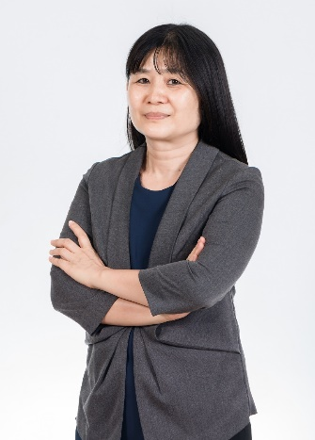
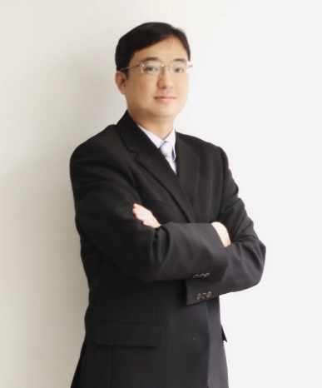
THAI - KIN
CSR Report 2017
Management Team
Ms. Hsu Chen Jung
President
Mr. Hsu Ta Chin
Chairman
Mr. Hsu Wen Chih
Production/Research & Development Vice President
Ms. Chang Pei Chi
Chief Internal Auditor
Ms. Ku Hsing Hua
Operations Vice President
Mr. Huang Cheng Hsiu
Chief Financial Officer

Slide 14
THAI - KIN
CSR Report 2017
Internal Audit
Internal Audit office is under BOD in Thai Kin organization and report to BOD meeting directly. We have full time internal auditors who were follow the qualification requirements of laws.
The internal auditors make the annual audit plan according to the risk assessment and propose the annual audit plan for the approval of Audit Committee and BOD meeting.
The Company perform full self-assessments of its internal control system. Its board of directors and management review the results of the self-assessments by each department at least annually and the reports of the internal audit department on a quarterly basis. The audit committee attend to and supervise these matters. Audit committees periodically hold discussions with their internal auditors about reviews of internal control system deficiencies. BOD meeting will approved and issue the Internal Control System Statement annually according to the result of self-assessments.
Thai Kin set up internal audit personnel according to the business scope of each company in the Group. Now there is one internal auditor in Parent company.

Slide 15
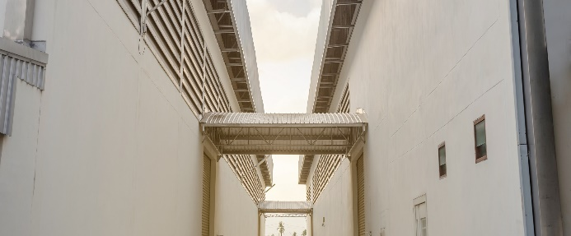
THAI - KIN
CSR Report 2017
Ethics and
Compliance
photo
Corporate Integrity Management
1. Formulation of Integrity Management Policy and Measures
Article 1 of TK business philosophy: Honoring the principle of good faith, abiding by an exacting code of professional ethics. The company clearly regulates the practice of this philosophy in the "Professional Code of Ethics," requiring all employees to understand and abide by the professional code of ethics and personal integrity. In addition, the Professional Code of Ethics for Directors explicitly states the need for directors to uphold the principle of good faith and abide by a behavior of professional standards. In order to foster a corporate culture of ethical management and sound development, and offer a reference framework for establishing good commercial practices. The company states the operating procedures, methods, violation penalties, and system of appeal in its Professional Code of Ethics, and provides employee training when encountering conflicts of interest each year in accordance with the provisions in the Professional Code of Ethics.

Slide 16
THAI - KIN
CSR Report 2017
The company shall periodically organize training and awareness programs for directors, managers, employees, mandataries, and substantial controllers and shall apply the policies of ethical corporate management when creating its employee performance appraisal system and human resource policies to establish a clear and effective reward and discipline system.
2. The Implementation of Integrity Management
The company shall adopt a concrete whistle-blowing system and scrupulously operate the system. The whistle-blowing system shall include the following:
An independent mailbox to allow company insiders and outsiders to submit reports.
Dedicated personnel or unit appointed to handle whistle-blowing system.
Documentation of case acceptance, investigation processes, investigation results, and relevant documents. Confidentiality of the identity of whistle-blowers and the content of reported cases.
Measures for protecting whistle-blowers from inappropriate disciplinary actions due to its whistle-blowing.
Whistle-blowing incentive measures.

Slide 17
THAI - KIN
CSR Report 2017
When the Audit Committee receives reports of suspected breaches of ethical corporate management best practice principles, it shall appoint suitable internal or external personnel to establish an investigatory group. The investigatory group shall comply with the principles of fairness and nondisclosure and perform investigations and compile reports to the Audit Committee.

Slide 18
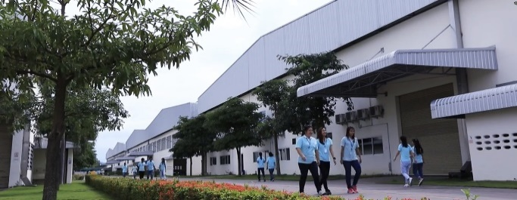
THAI - KIN
CSR Report 2017
Human
Resources
Employee Data
The total number of employee at Thai – KIN as of March 31, 2017 was approximately 1,300 an increase of approximately 400 from March 31, 2016.
Diversity
As a company with a broad global business portfolio encompassing metal casting. Thai – Kin employs individuals of diverse backgrounds, including different nationalities and genders, With it while range of different personnel and businesses. Thai – Kin acted to promote diversity globally by adopting the Diversity Policy; there is no discrimination with regards to Workers based on race, religion, gender identity, marital or family status, age, political affiliation, nationality, physical ability, sexual orientation, ethnicity or any other dimension of their identity during recruitment and employment. All Workers, including contracted and sub – contracted Workers, have equal rights and social benefits, unless legal restrictions apply.

Slide 19
THAI - KIN
CSR Report 2017
Recruitment
Recruitment routines and recruitment agents
All steps taken in the recruitment process and all agents involved in the entire process are identified and documented.
Any agent recruiting Workers has the legal license to perform such activities.
Employment contracts
A written employment contract is signed with each Worker before they start work, which specifics terms of employment in a way understood by Worker.
As a minimum the contract includes the name of employer, name of Worker, birth date, position, salary, working hours, overtime compensation, benefit and notice period can instead be described in a Workers Handbook or equivalent.
If the employment contract is terminated according to agreed notice period there are no wage deduction for Workers who leave.

Slide 20
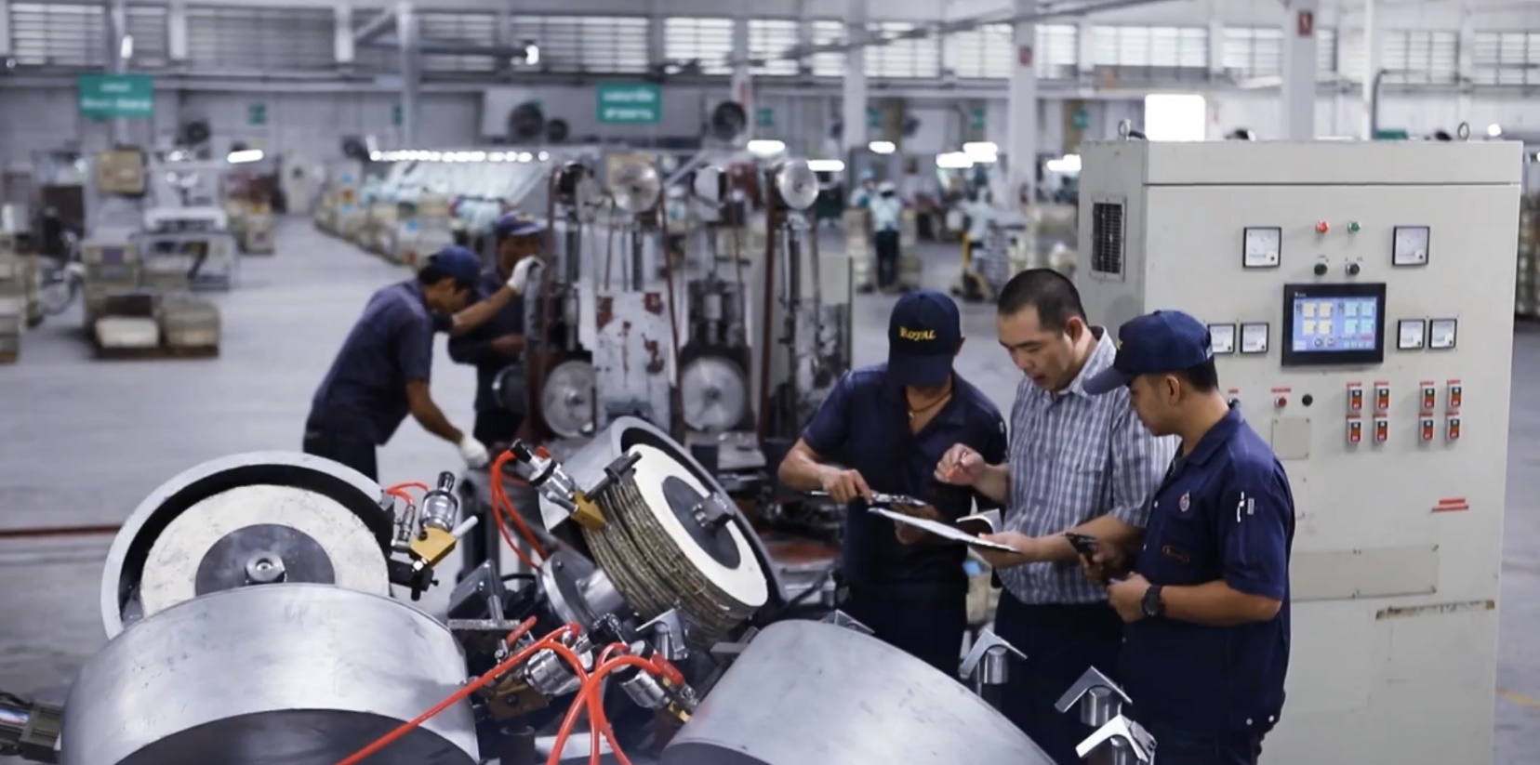
THAI - KIN
CSR Report 2017
Training and Talent Development
The development and vitality of its employees drive Thai – Kin’s dynamic growth. Thai – Kin recognizes its people as its most important management asset and the growth of its people as a crucial aspect of its management foundation. Thai – Kin strives to further enhanced motivation and encourage personal growth for as employees through on-the-job learning, as well as through access to a variety of programs designed to enhance individual abilities and skills and tailored to local needs.

Slide 21
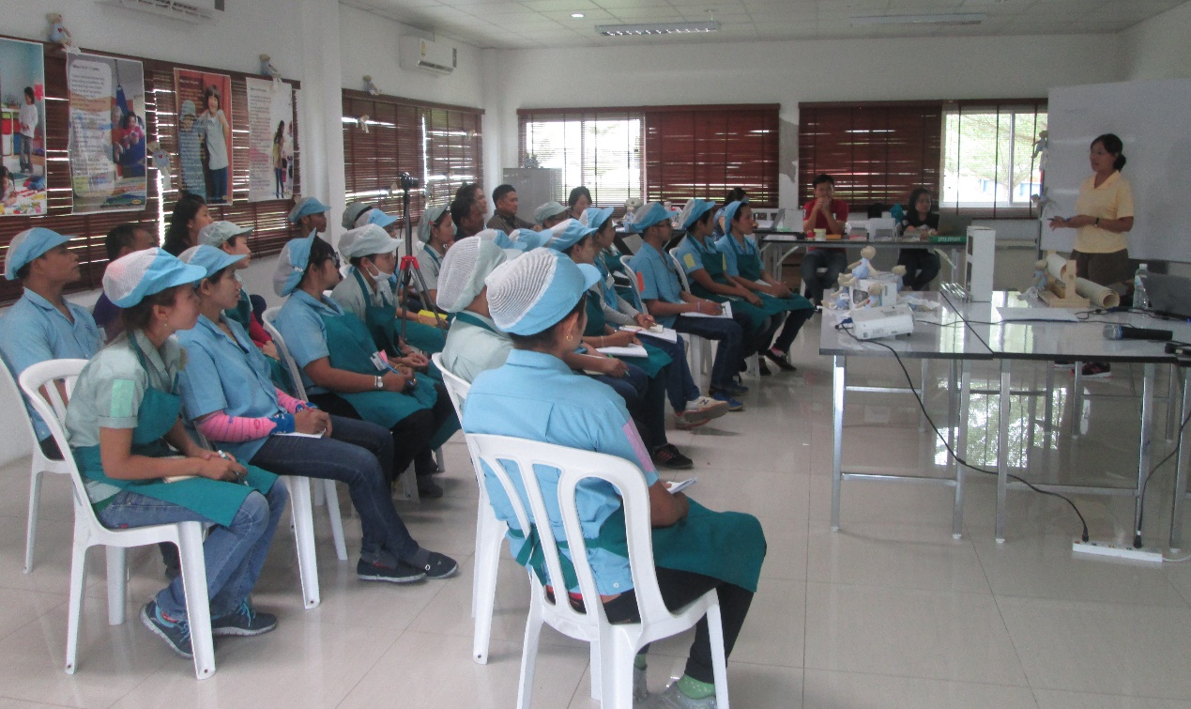
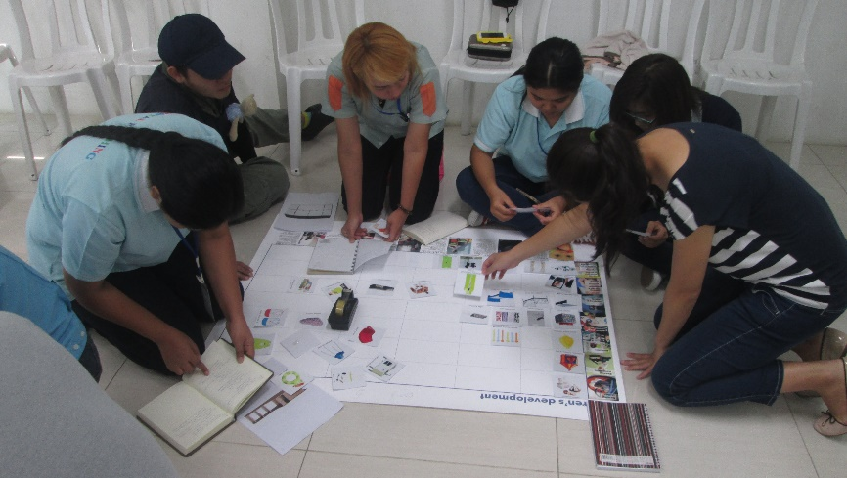
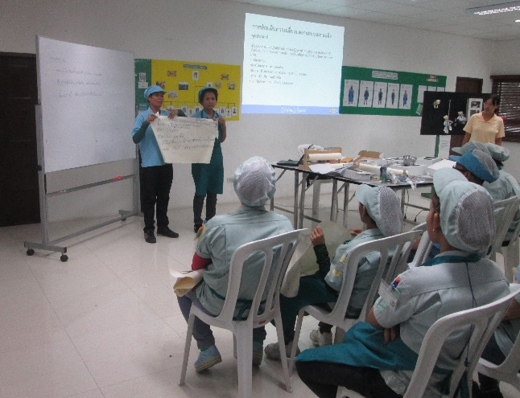
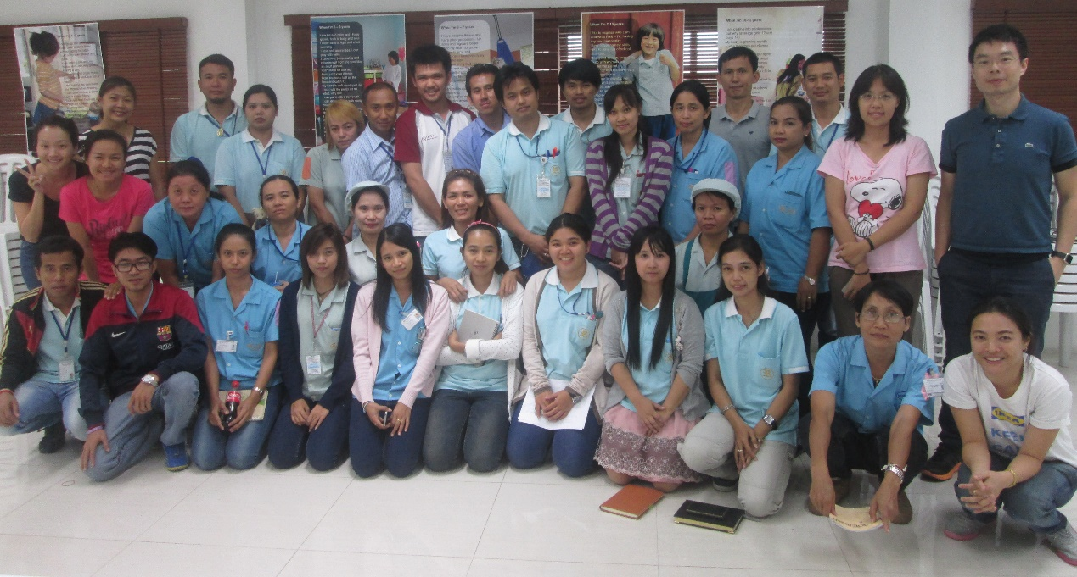
THAI - KIN
CSR Report 2017
Child Product Safety Workshop, Thai – Kin top management with staffs participated in the workshop together.

Slide 22
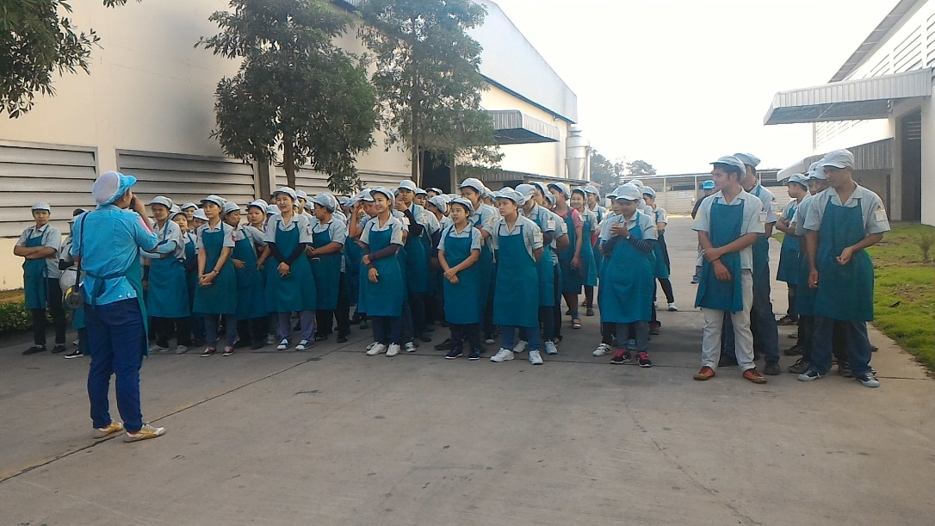
THAI - KIN
CSR Report 2017
Communication
Thai – Kin is committed to a productive and satisfying work environment that operates efficiently and effectively. Our company believes clear, respectful, accurate, coordinated and timely workplace communication between the Management Committee, Coordinator, and worker is very important. This policy is intended to provide a framework for good communication within the work environment of the [Thai - Kin]. The purpose is to ensure Management Committee members, Coordinator, and workers are well informed, understand how the company operates, support each other, carry out their daily tasks efficiently and effectively, and are focused on the issues we are dealing with and the strategic vision it is working towards. The policy applies to workplace communication between Management Committee members, Coordinator and workers.

Slide 23
THAI - KIN
CSR Report 2017
Grievance routines
There are documented routines on how to bring up issues and complaints e.g. around discrimination, harassment or abuse. These grievance routines are well known to every Workers.
Freedom of association
Thai – Kin respects the rights of Workers to join, form or not to join an association of their choice without fear of reprisal, interference, intimidation or harassment.
In countries where the right to freedom of association is regulated, restricted or prohibited by law, Thai – Kin does not hinder alternative forms of independent and free Worker representation.
Collective bargaining
Workers are free to exercise collective bargaining without fare of reprisal, interference, intimidation or harassment.
In countries where the right to collective bargaining is regulated, restricted or prohibited by law, Thai – Kin does not hinder alternative forms of independent and free Workers negotiations.

Slide 24
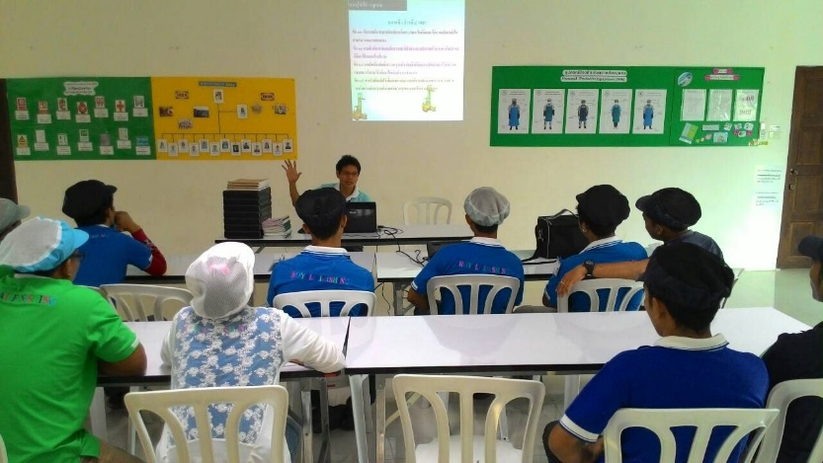
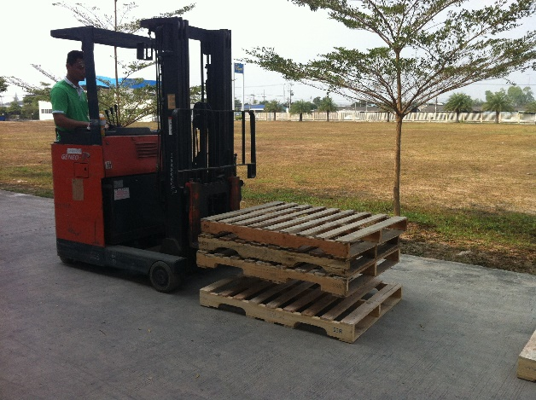
THAI - KIN
CSR Report 2017
Occupational Health and Safety
Thai – Kin is committed to the goal of providing and maintaining a healthy and safe working environment, with a view to continuous improvement. This goal is only achievable by adherence to established objectives striving to exceed all obligations under applicable legislation, and by fostering an enthusiastic commitment to health, safety and the environment within Thai – Kin personnel, contractors and visitors.
In particular:
Management, working in cooperation with the Safety Committee, will strive to take all reasonable steps to reduce workplace hazards to as low as reasonably achievable.
Supervisors, workers and visitors are expected to perform their duties and responsibilities in a safe and healthful manner, and are accountable for the Health and Safety of themselves and others.
Forklift Safety Training at Royal Finishing - Thailand

Slide 25
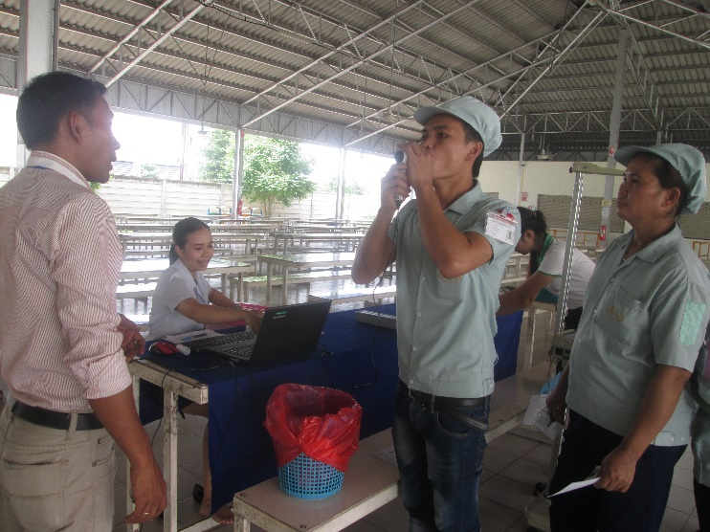
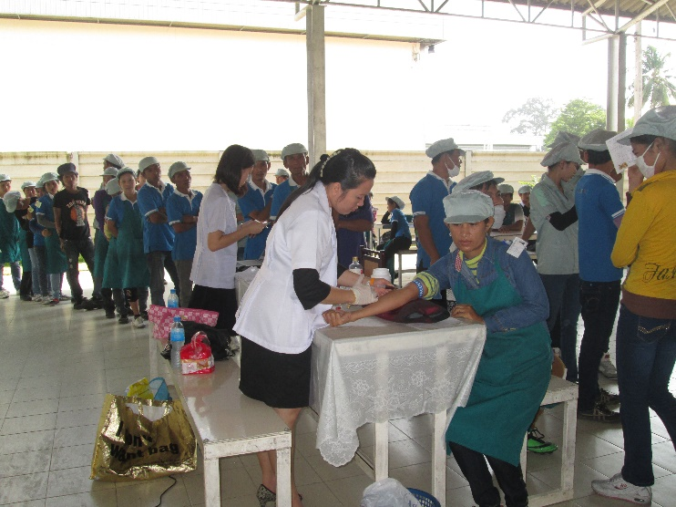
THAI - KIN
CSR Report 2017
Thai – Kin is committed to providing all necessary training and instruction to ensure that appropriate work practices are followed on the job, and to promote their use off the job.
If necessary, Thai – Kin will take disciplinary action where individuals fail to work in a healthy and safe manner, or do not comply with applicable legislation or corporate policies and procedures.
Supervisors and managers are held accountable for the health and safety of all employees under their supervision. This includes responsibility for applicable training and instruction, appropriate follow up on reported health and safety concerns, and implementation of recommended corrective action. This accountability is integrated into the performance appraisal system.
Annual Health checkup at Royal Finishing - Thailand

Slide 26
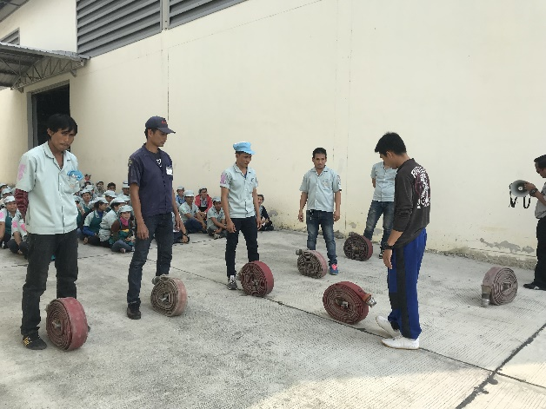
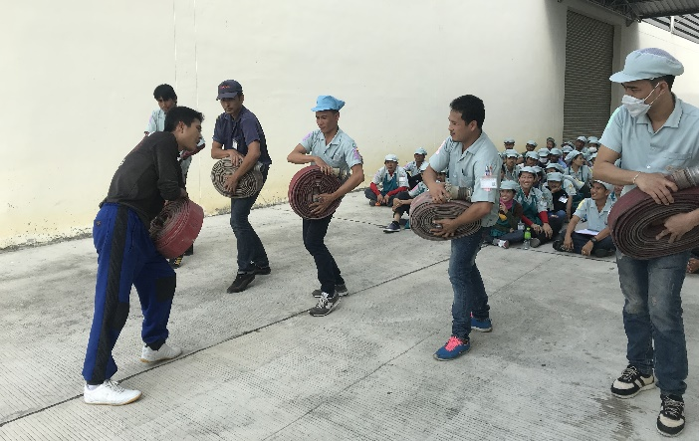
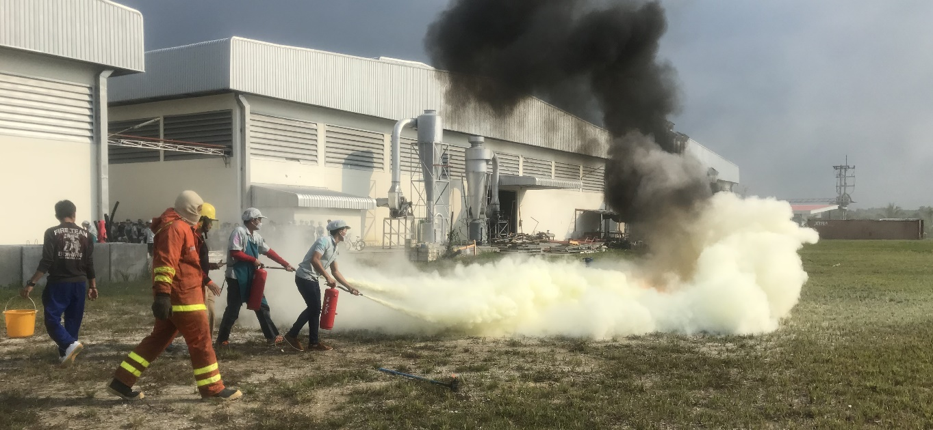
THAI - KIN
CSR Report 2017
Health, safety, the environment and loss control in the workplace are everyone’s responsibility. Thai – Kin expects that everyone will join in our efforts to provide a healthy and safe working environment on a continuous day to day basis. Only through the dedication and efforts of all individuals can Thai – Kin succeed in providing a healthy safe working environment.
Fire Safety training at Royal Finishing - Thailand

Slide 27
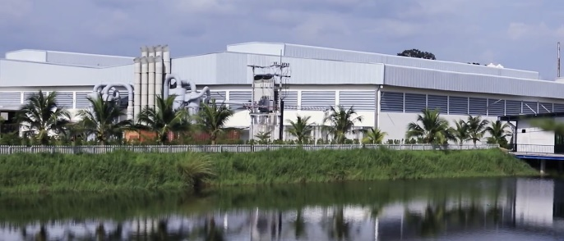
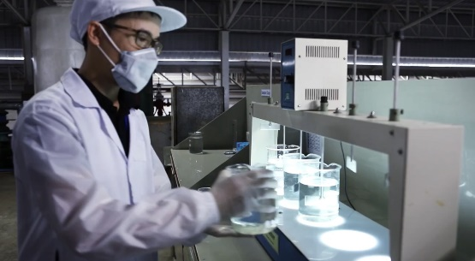
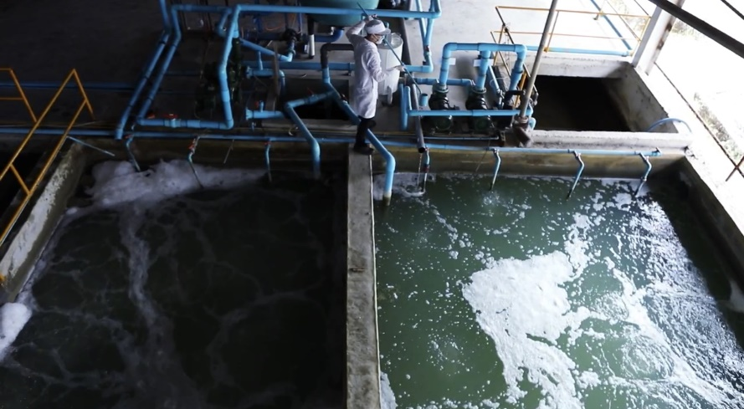
THAI - KIN
CSR Report 2017
Environment
Thai - Kin attaches great importance to the protection of the environment and regard it as a major corporate responsibility, including:
to save energy. A lot of funds will be invested in the installation of the roof of solar panels as power generation.
to build the Self-built sewage treatment equipment.
to build the Self-built sewage treatment equipment. to save water resources by digging natural reservoirs as well as the use of rainwater storage for production use. These reservoirs can be home to many animals and plants.

Slide 28
THAI - KIN
CSR Report 2017
Natural water reservoir for rainwater storage and utilize rainwater storage for factory production.

Slide 29
THAI - KIN
CSR Report 2017
Community
Engagement
Thai - Kin is committed effectively with its community in a meaningful, responsive and equitable way. This Policy outlines Thai - Kin’s position, role and commitments to ensure community engagement is integrated into Thai - Kin activities to support decision making, build relationships and strengthen communities. The Policy also seeks to improve Thai - Kin’s engagement processes and outcomes through encouraging a consistent approach and continual learning through evaluation, and through expanding the range of engagement methods used. Community engagement is the responsibility of all Thai -Kin service areas, teams and employees. To ensure the effective application of engagement principles and processes, a Community Engagement Toolkit will be developed to provide guidance for Thai - Kin employees.

Slide 30
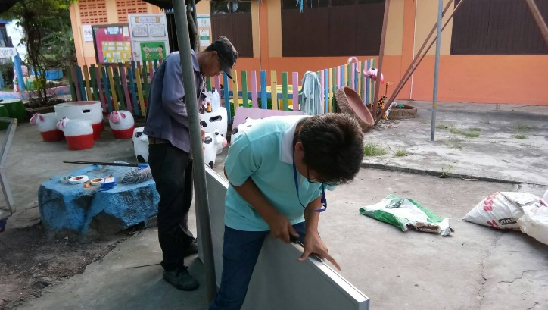
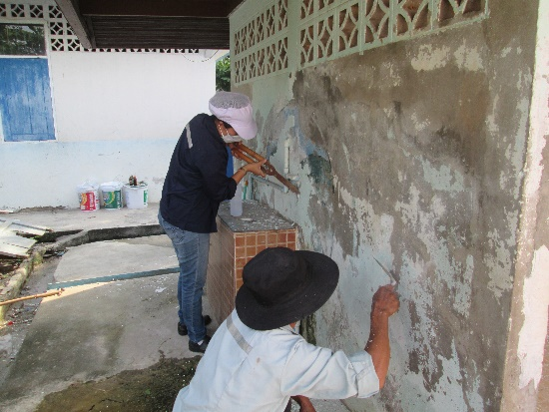
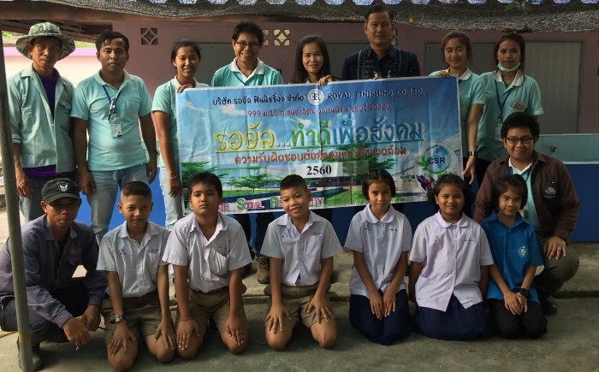
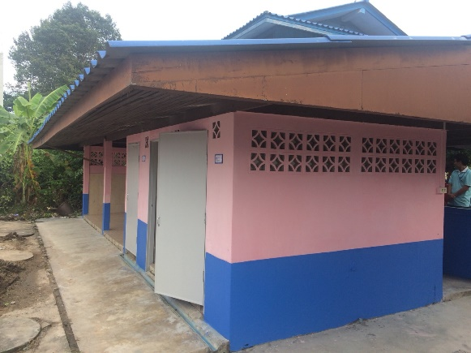
THAI - KIN
CSR Report 2017
Thai – Kin staffs volunteer to maintenance facilities in the community’s school - Thailand

Slide 31
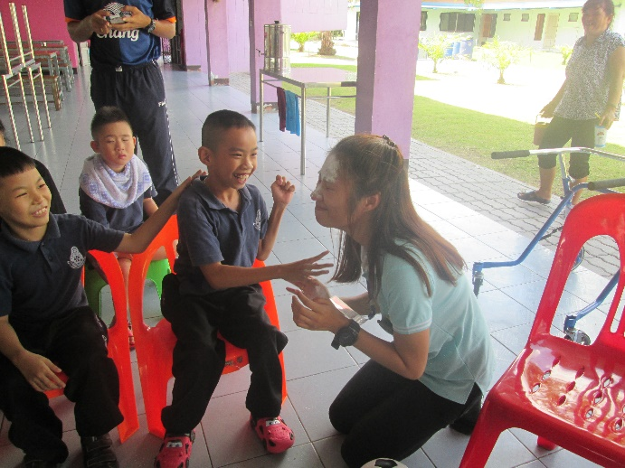
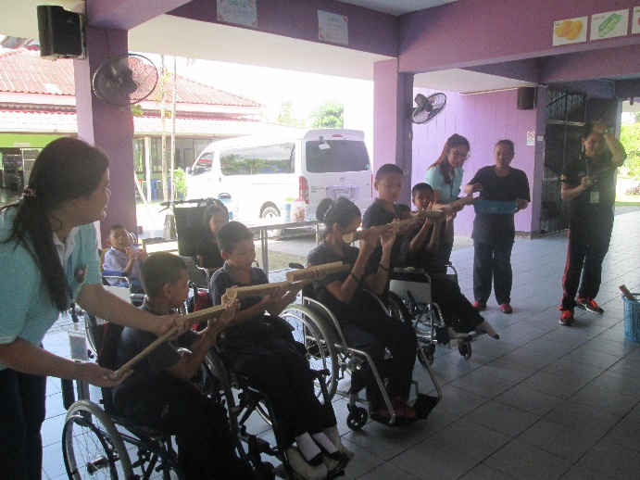
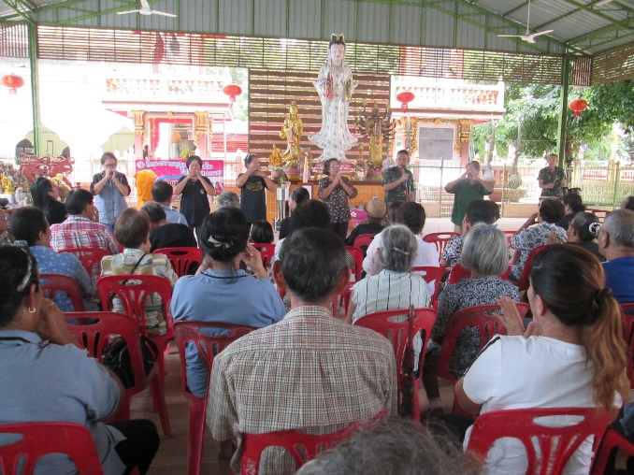
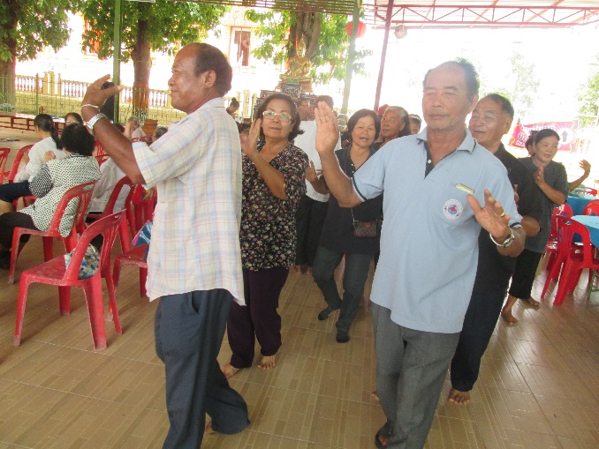
THAI - KIN
CSR Report 2017
Play and Learn activity at Special Education for Disabled Child Center - Thailand
Taking good care of elderly person in the community is also very important vision of Thai – Kin.

